Slide 1

Data Structure Design II
Chris Piech
CS106A, Stanford University

Slide 2
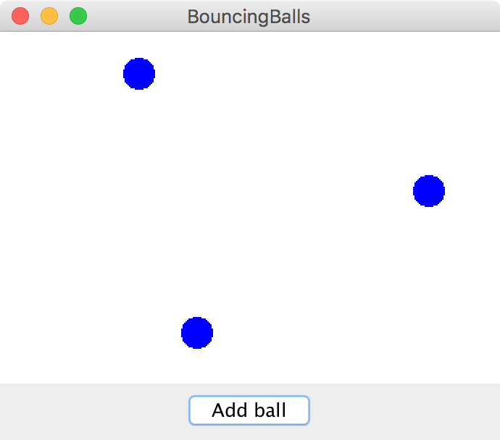
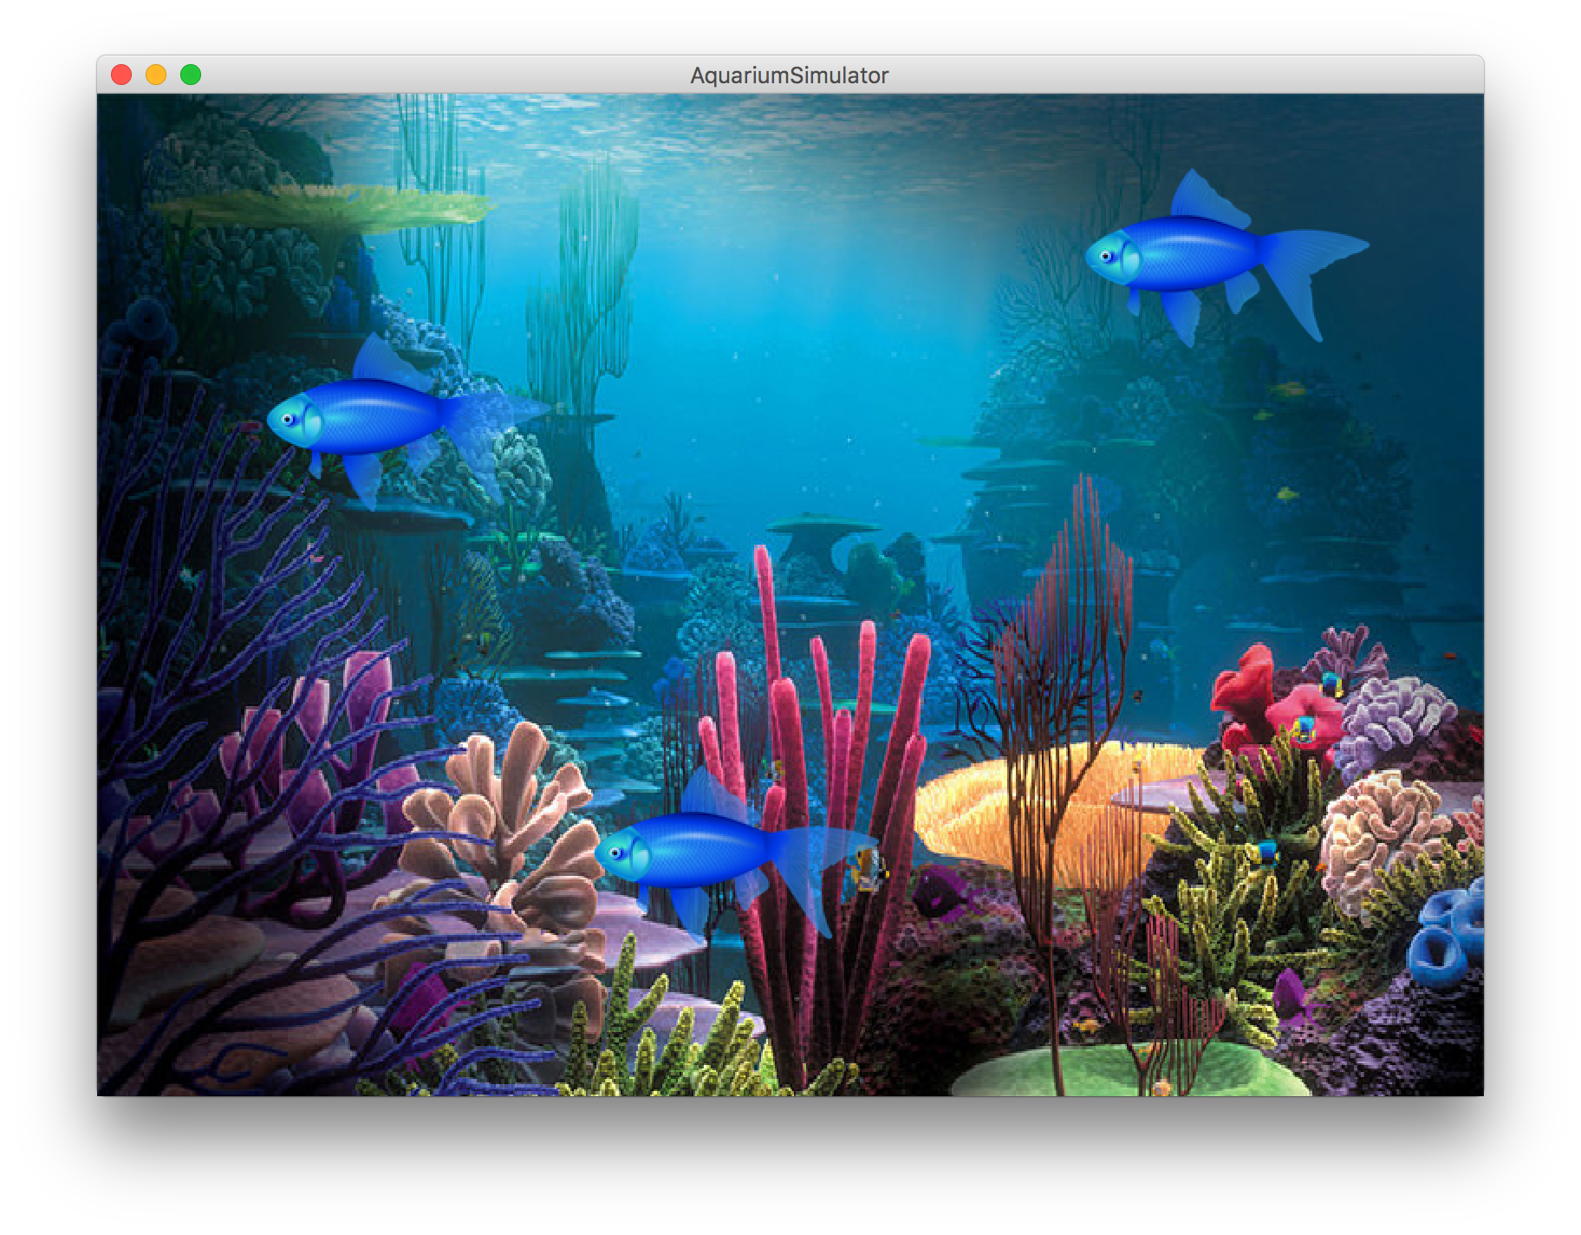
Today in lecture

Slide 3
We have used many variable types

Slide 4
E.g. GRect

Slide 5
E.g. String

Slide 6
E.g. AudioSample

Slide 7
Today we learn how to define our own

Slide 8
We use Classes (written in new files) to defined new variable types

Slide 9
You must define three things
1. What variables does each instance store?
2. What methods can you call on an instance?
3. What happens when you make a new one?
*details on how to define these three things coming soon

Slide 10
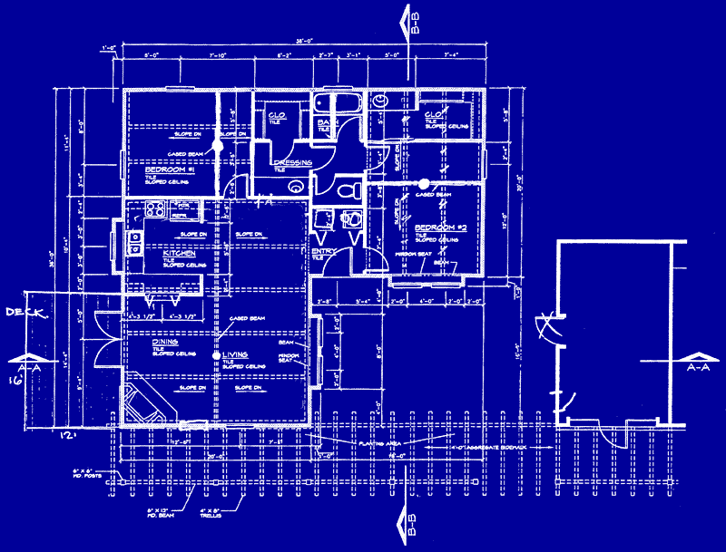

Classes are like blueprints
class: A template for a new type of variable.

Slide 11
What does a class do?

Slide 12
A class defines a new variable type

Slide 13
Bouncing Balls

Slide 14
A Ball Variable Type
The Ball class
1. What variables does each instance store?
Each ball has its own Goval (lets call it shape)
Each ball has its own dx
Each ball has its own dy
2. What methods can you call on an instance?
heartbeat();
getShape();
3. What happens when you make a new one?
Sets initial values for all the ”instance” vars
*details on how to define these three things coming soon

Slide 15
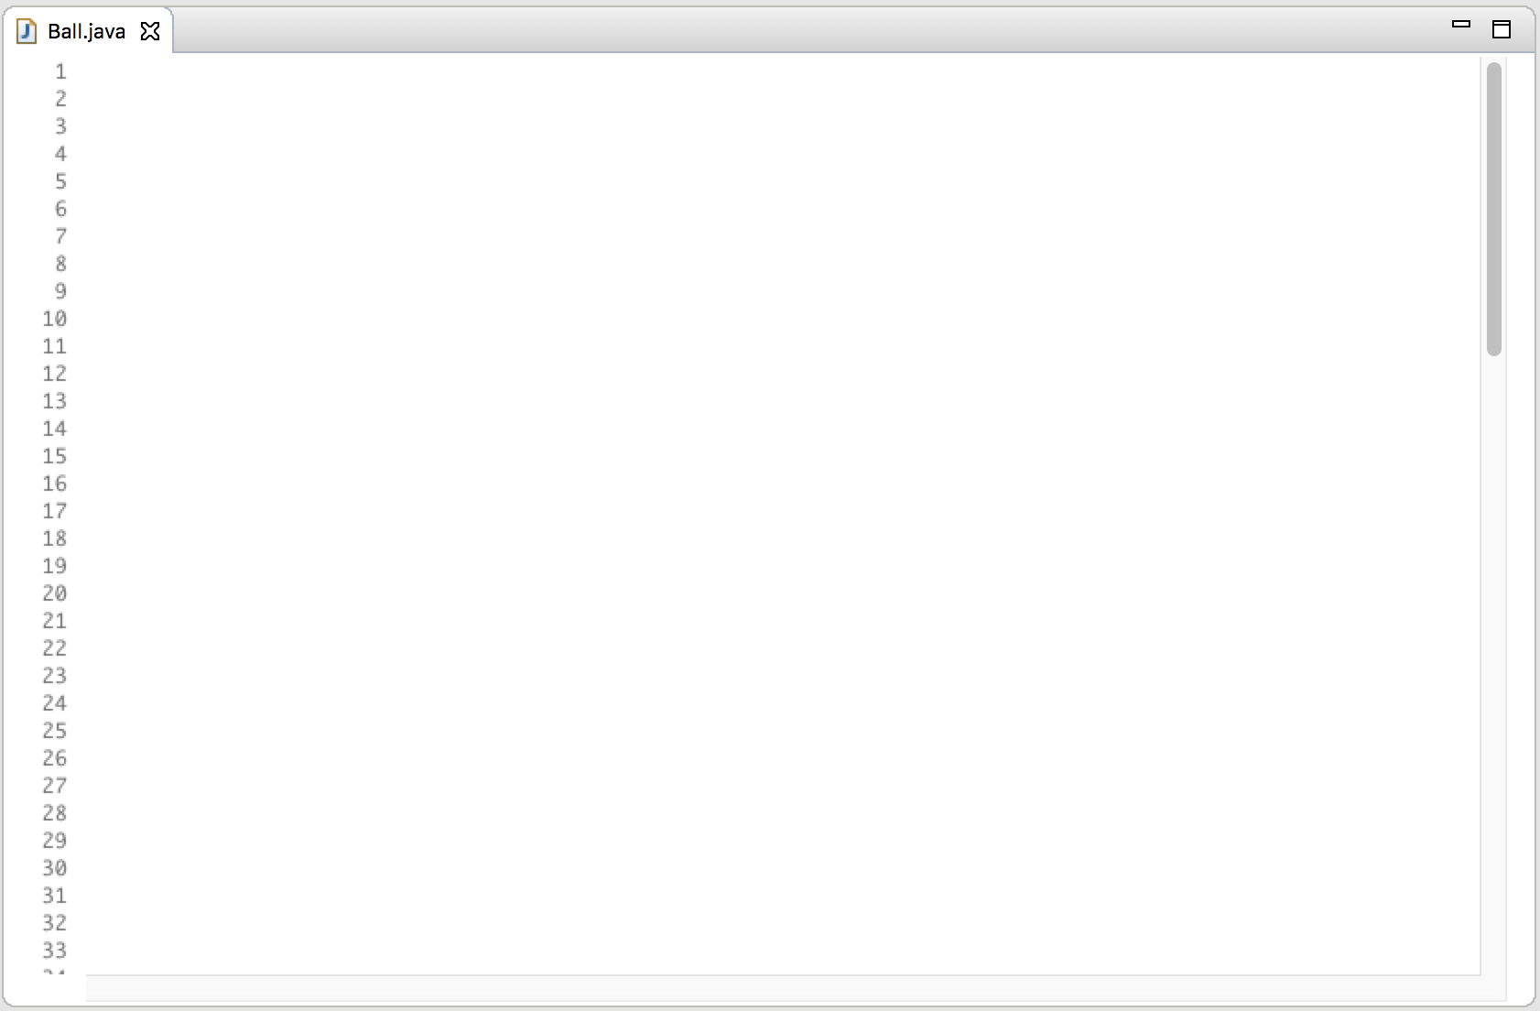
public class Ball {
/* instance vars! */
// each ball has a “shape”
private GOval shape = null;
// each ball has a dx
private double dx = 0.0;
// each ball has a dy
private double dy = 0.0;
...
1. Instance vars define what makes up a variable of type Ball

Slide 16
public class Ball {
/* instance vars! */
// each ball has a “shape”
private GOval shape = null;
// each ball has a dx
private double dx = 0.0;
// each ball has a dy
private double dy = 0.0;
// This defines what happens when you make a new ball
public Ball(int screenWidth, int screenHeight) {
RandomGenerator rg = RandomGenerator.getInstance();
double x = rg.nextInt(screenWidth - BALL_SIZE);
double y = rg.nextInt(screenHeight - BALL_SIZE);
shape = new GOval(x, y, BALL_SIZE, BALL_SIZE);
shape.setFilled(true);
shape.setColor(Color.BLUE);
dx = getRandomSpeed();
dy = getRandomSpeed();
}
...
2. The constructor defines what happens when you call new

Slide 17
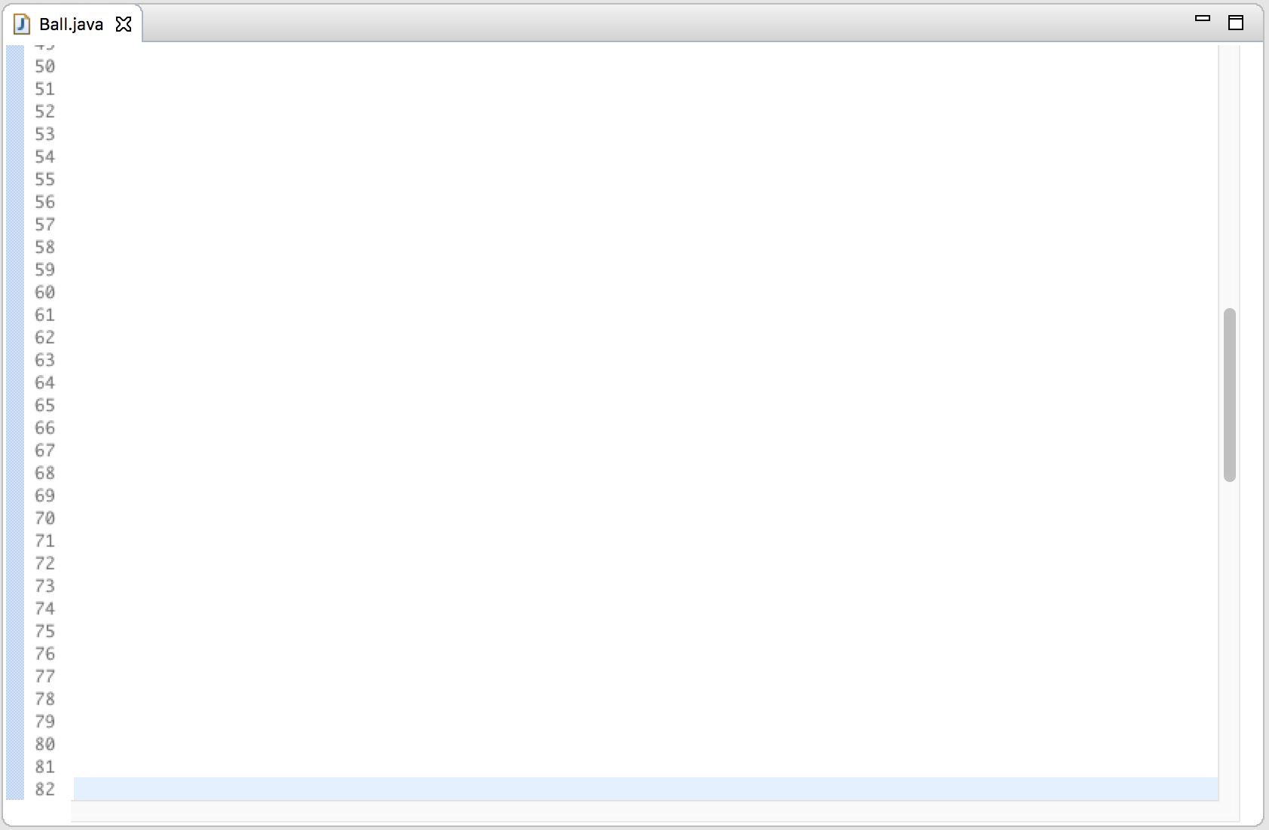
public void heartbeat(int screenWidth, int screenHeight) {
shape.move(dx, dy);
reflectOffWalls(screenWidth, screenHeight);
}
public GOval getShape() {
return shape;
}
...
3. Public methods define what methods the “client” can call on instances

Slide 18
public void heartbeat(int screenWidth, int screenHeight) {
shape.move(dx, dy);
reflectOffWalls(screenWidth, screenHeight);
}
public GOval getShape() {
return shape;
}
private void reflectOffWalls(int sWidth, int sHeight) {
if(shape.getY() < 0) {
dy *= -1;
}
if(shape.getY() > sHeight - BALL_SIZE) {
dy *= -1;
}
if(shape.getX() < 0) {
dx *= -1;
}
if(shape.getX() > sWidth - BALL_SIZE) {
dx *= -1;
}
}
4. Private methods are allowed

Slide 19
What does a class do?

Slide 20
A class defines a new variable type

Slide 21
You must define three things
1. What variables does each instance store?
2. What methods can you call on an instance?
3. What happens when you make a new one?

Slide 22
Wait… if each instance has a copy of each instance variable. How does Java know which one to use?

Slide 23
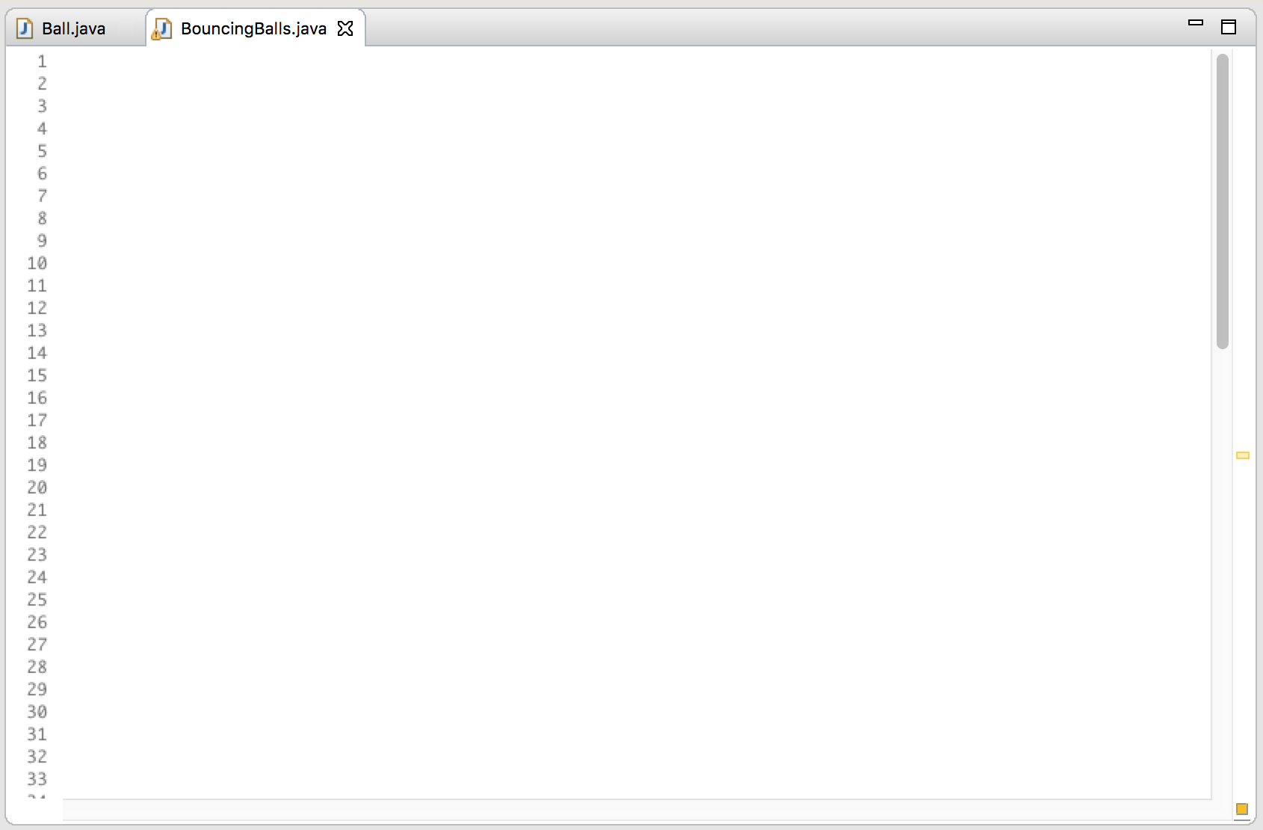
public class BouncingBalls extends GraphicsProgram {
public void run() {
// make a few new balls
Ball a = new Ball(getWidth(), getHeight());
Ball b = new Ball(getWidth(), getHeight());
// call a method on one of the balls
a.heartbeat(getWidth(), getHeight());
}
}
run
a
dx = 1.0
dy = 1.5
b
dx = -1.2
dy = -1.1

Slide 24
public class BouncingBalls extends GraphicsProgram {
public void run() {
// make a few new balls
Ball a = new Ball(getWidth(), getHeight());
Ball b = new Ball(getWidth(), getHeight());
// call a method on one of the balls
a.heartbeat(getWidth(), getHeight());
}
}
public void heartbeat(int screenWidth, int screenHeight) {
shape.move(dx, dy);
reflectOffWalls(screenWidth, screenHeight);
}
run
a
dx = 1.0
dy = 1.5
b
heartbeat
this
sWidth
800
dx = -1.2
dy = -1.1
sHidth
600

Slide 25
public class BouncingBalls extends GraphicsProgram {
public void run() {
// make a few new balls
Ball a = new Ball(getWidth(), getHeight());
Ball b = new Ball(getWidth(), getHeight());
// call a method on one of the balls
a.heartbeat(getWidth(), getHeight());
}
}
public void heartbeat(int screenWidth, int screenHeight) {
shape.move(dx, dy);
reflectOffWalls(screenWidth, screenHeight);
}
run
a
dx = 1.0
dy = 1.5
b
heartbeat
this
sWidth
800
dx = -1.2
dy = -1.1
sHidth
600

Slide 26
Tl;dr: Java knows which Ball
you called heartbeat on

Slide 28
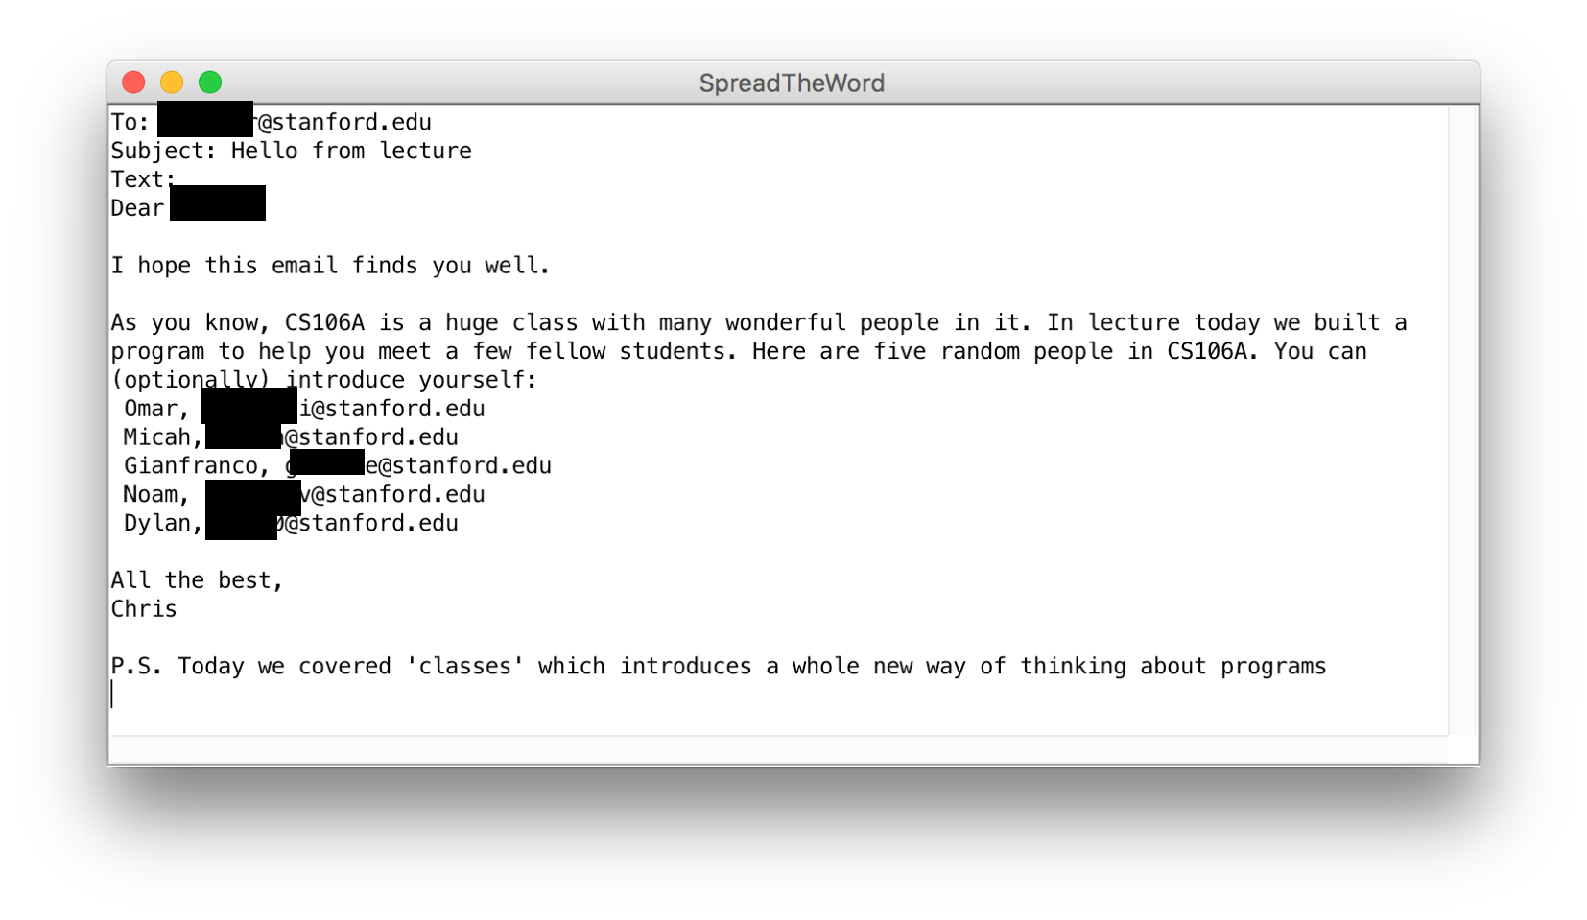

Slide 29
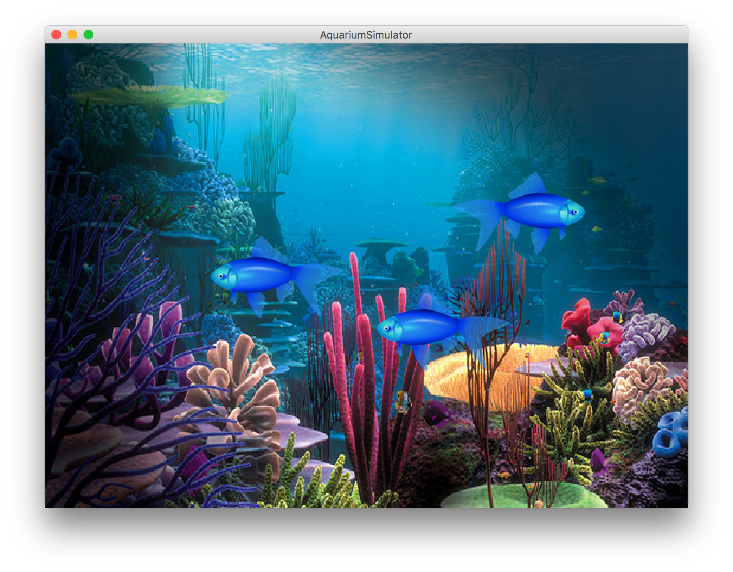

Slide 30
heartbeat
Tank
Fish
getImage
Wall of abstraction

Slide 31
Adding Privacy
private boolean isLeftImgShown;
encapsulation: Hiding implementation details of an object from its clients.
Encapsulation provides abstraction.
separates external view (behavior) from internal view (state)
Encapsulation protects the integrity of an object's data.
A class's instance variables should be declared private.
No code outside the class can access or change it.

Slide 32
What does a class do?

Slide 33
A class defines a new variable type

Slide 34
You must define three things
1. What variables does each instance store?
2. What methods can you call on an instance?
3. What happens when you make a new one?

Slide 35
More Practice
See Days Until

